Slide 1
Data Engineering using R
Fátima Sánchez-Cabo, PhD
CNIC Bioinformatics Unit

Slide 2


Slide 3
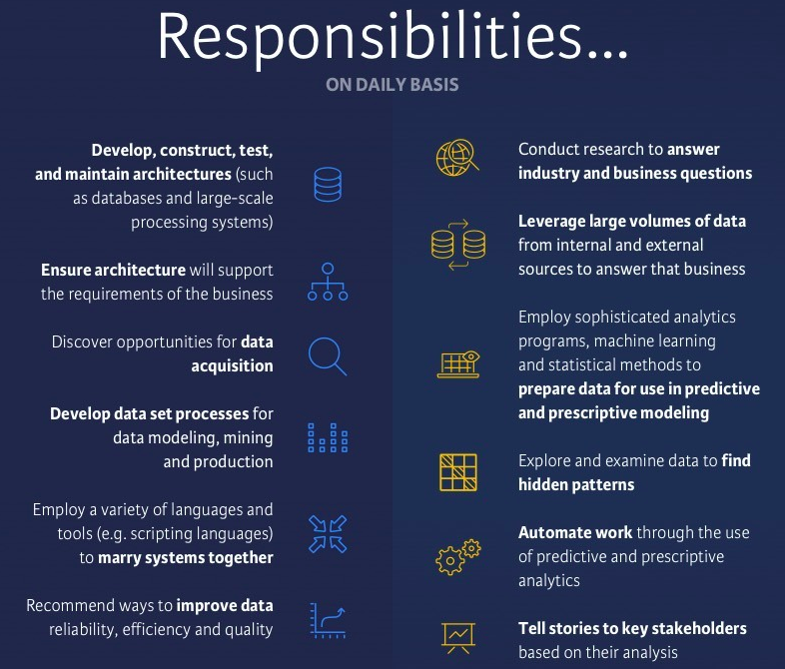

Slide 4


Slide 5


Slide 6
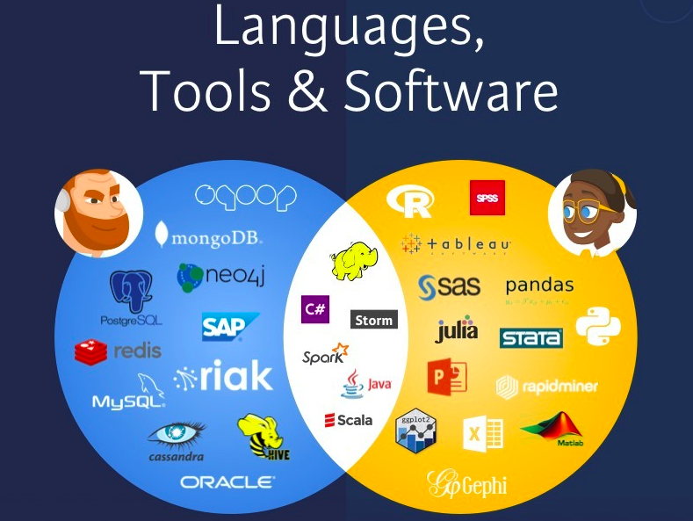

Slide 7
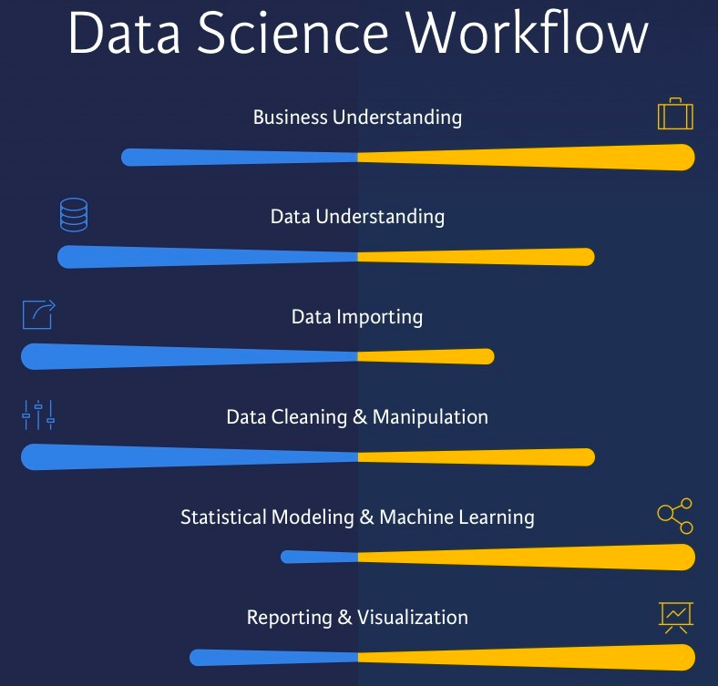

Slide 8

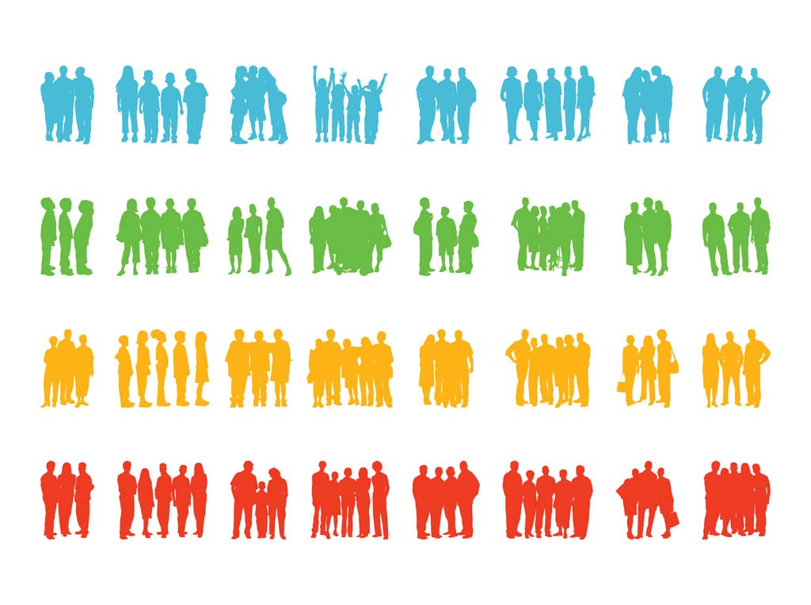


Big Data at CNIC
N>17.000
100.000 variables
New project: 2 Million individuals x 3 years

Slide 9

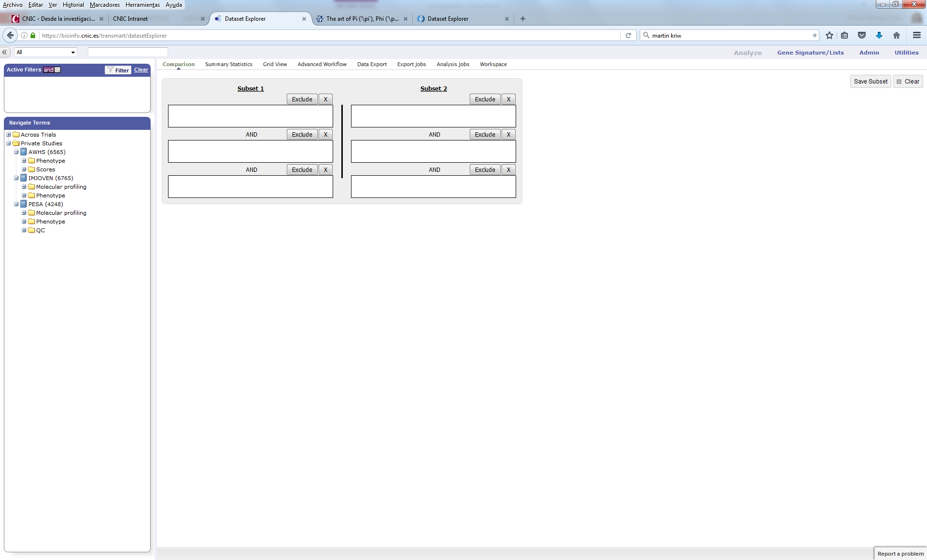
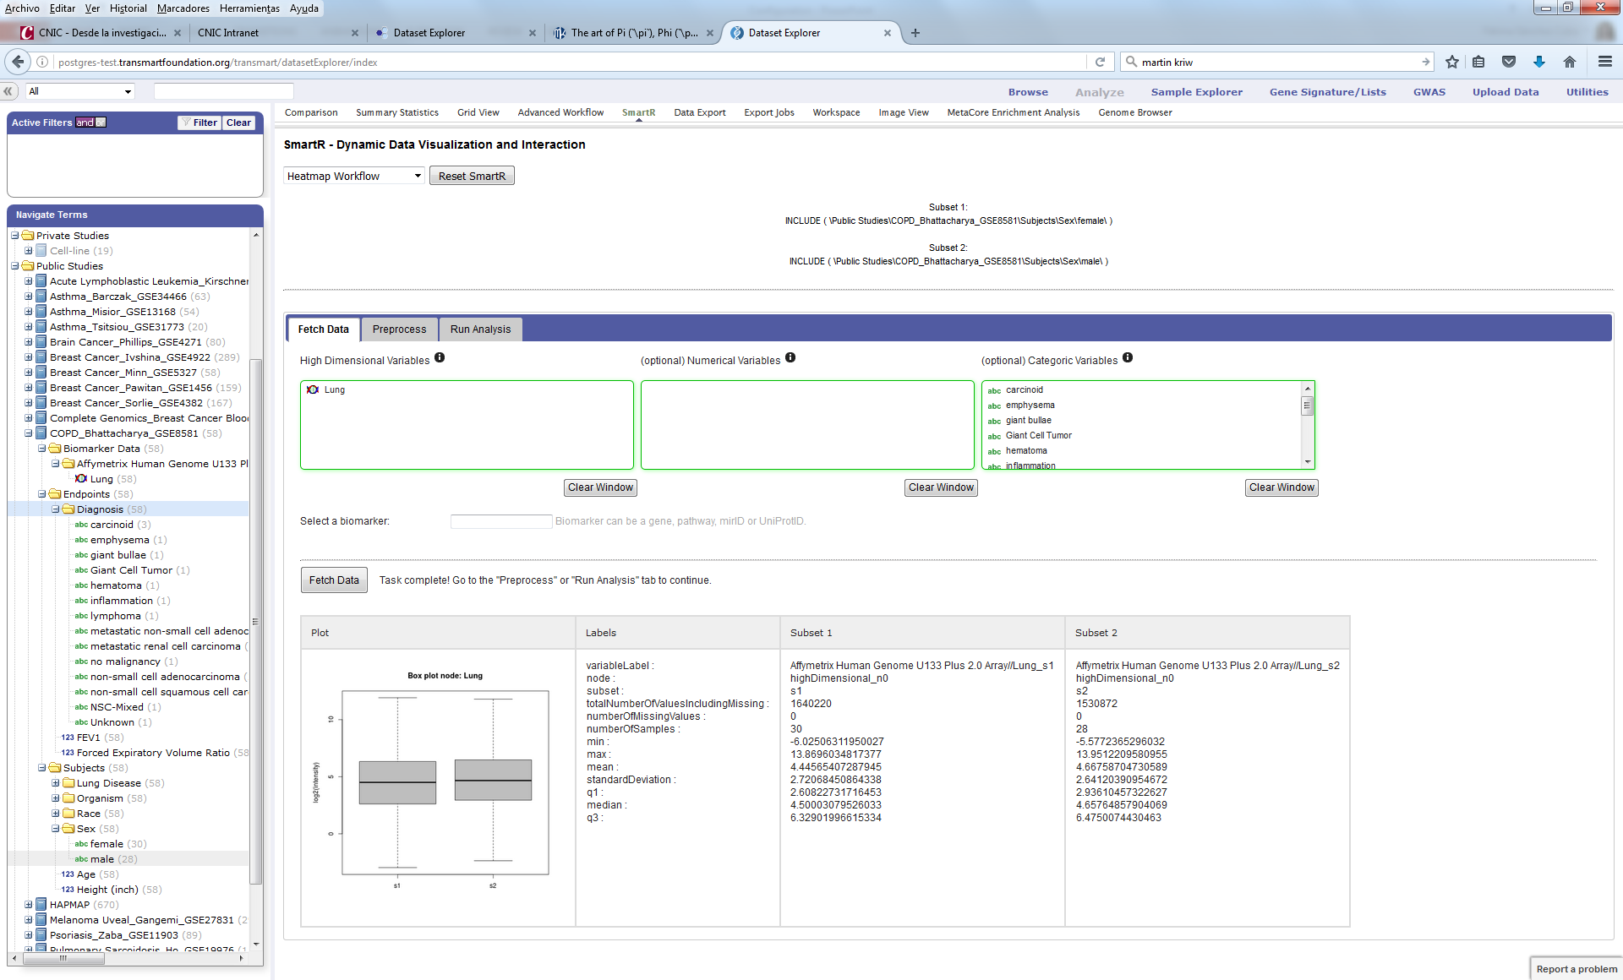
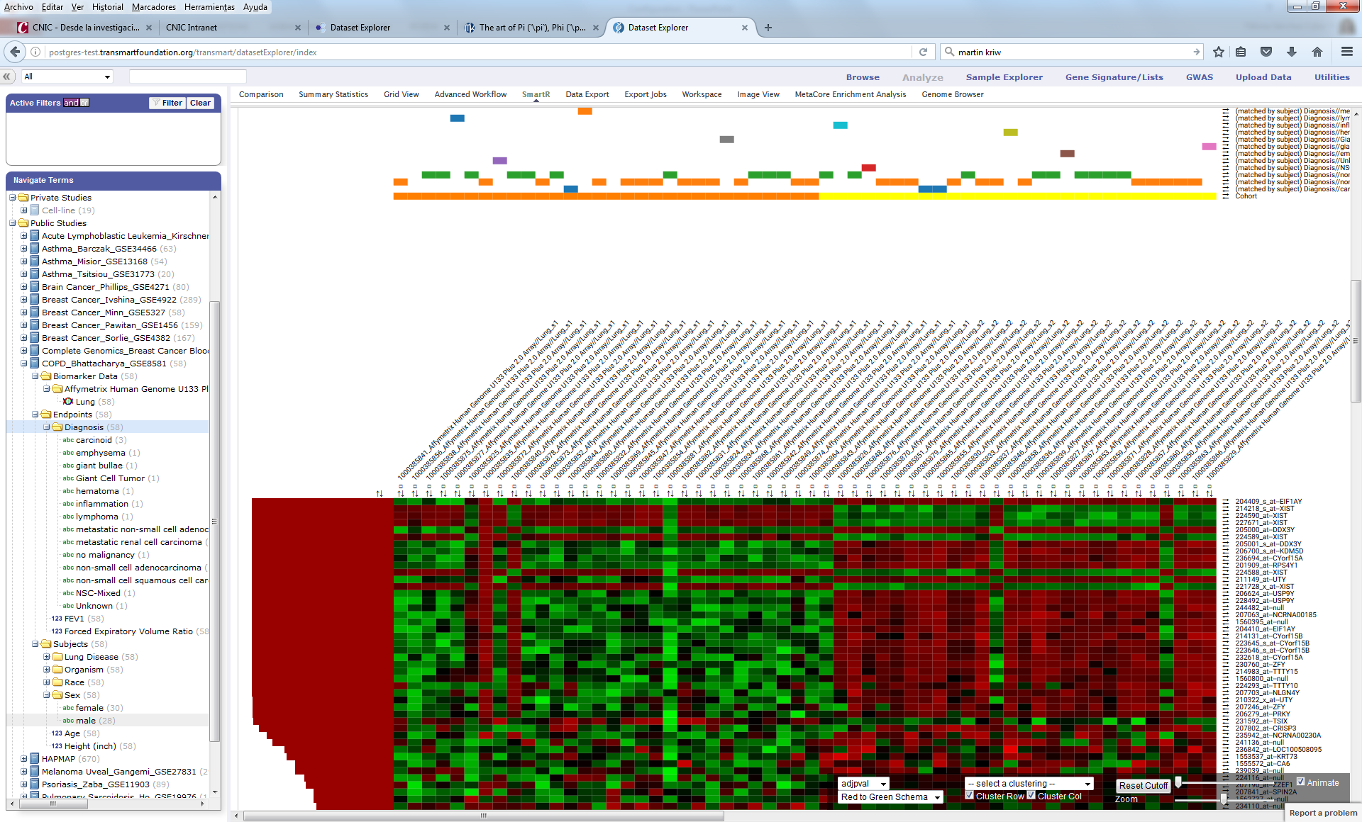

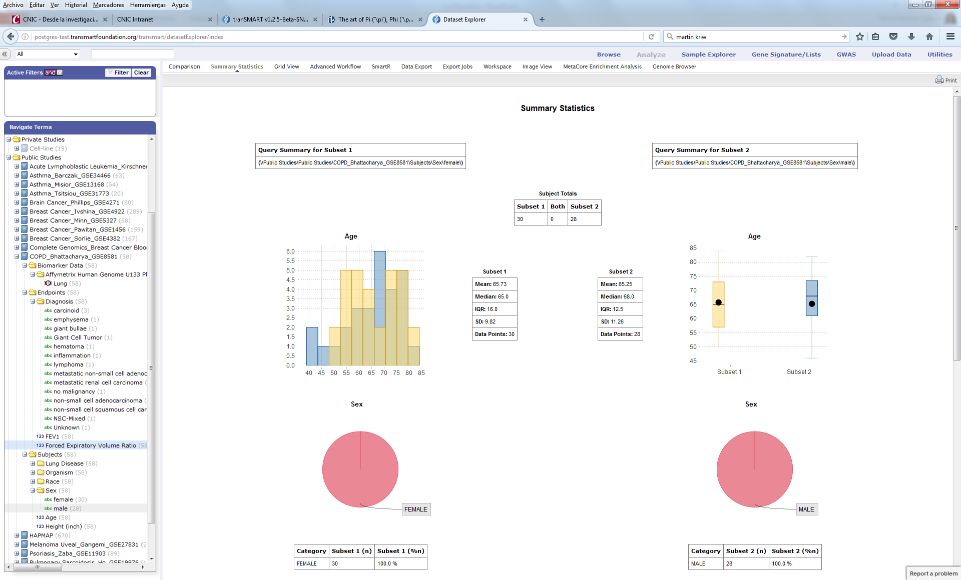

Medical Imaging
Health/LS records
Biobank
Multi-OMICS
ETL
ETL
ETL
Big Data Technology
for Data Integration
ETL
Contextual
Databases
ETL
Literature
Artificial Intelligence
Algorithms
Pathways
Ontologies
Annotation
Translational results
Improved healthcare

Slide 10
What you already know
How to import data in R from:
Excel
Web
Databases (API)
How to clean data:
Outliers detection
Time series de-trending and seasonally adjusting
How to wrangle data:
dplyr
tidyverse

Slide 11
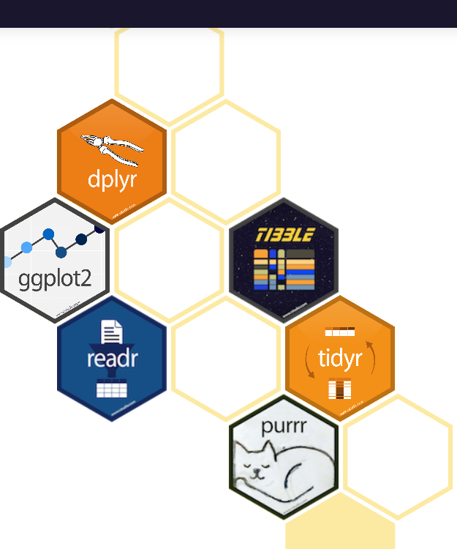
The tidyverse is an opinionated collection of R packages designed for data science. All packages share an underlying design philosophy, grammar, and data structures.

Slide 12
What we are going to learn today
Cleaning data with the janitor R package
Feature Engineering (DataExplorer):
Feature engineering is the process of creating new features from existing ones
Newly engineered features often generate valuable insights
Topics:
Dealing with missing values
Recoding into dummy
Data imputation (mice)
Oversampling: SMOTE+NEATER

Slide 13
DataExplorer::tabyl()
adorn_totals():
Add totals row, column, or both. Replaces the older janitor functions add_totals_row and add_totals_col
adorn_percentages():
Calculate percentages along either axis or over the entire tabyl
adorn_pct_formatting():
Format percentage columns, controlling the number of digits to display and whether to append the % symbol
adorn_rounding():
Round a data.frame of numbers (usually the result of adorn_percentages), either using the base R round() function or using janitor's round_half_up() to round all ties up (thanks, StackOverflow).e.g., round 10.5 up to 11, consistent with Excel's tie-breaking behavior. This contrasts with rounding 10.5 down to 10 as in base R's round(10.5).
adorn_ns():
add Ns to a tabyl. These can be drawn from the tabyl's underlying counts, which are attached to the tabyl as metadata, or they can be supplied by the user.
adorn_title():
add a title to a tabyl (or other data.frame). Options include putting the column title in a new row on top of the data.frame or combining the row and column titles in the data.frame's first name slot.

Slide 14
Data imputation for missing values: mice
Multivariate Imputation via Chained Equations: takes care of uncertainty in missing values by multiple imputation vs one single imputation
MICE assumes that the missing data are Missing at Random (MAR), which means that the probability that a value is missing depends only on observed value and can be predicted using them.
It imputes data on a variable by variable basis by specifying an imputation model per variable.
For example: Suppose we have X1, X2….Xk variables. If X1 has missing values, then it will be regressed on other variables X2 to Xk. The missing values in X1 will be then replaced by predictive values obtained. Similarly, if X2 has missing values, then X1, X3 to Xk variables will be used in prediction model as independent variables. Later, missing values will be replaced with predicted values.
By default, linear regression is used to predict continuous missing values. Logistic regression is used for categorical missing values. Once this cycle is complete, multiple data sets are generated. These data sets differ only in imputed missing values. Generally, it’s considered to be a good practice to build models on these data sets separately and combining their results.

Slide 15
mice
Methods:
Numeric vars: PMM (Predictive Mean Matching)
Binary outcomes: logreg (Logistic Regression)
Categorical (>2 levels): polyreg(Bayesian polytomous regression)
Ordered (> 2 levels): Proportional odds model

Slide 16
Imputation in time series
Dependencies between observations exist in time series
Specific packages to use them:
imputeTS
zoo
forecast
timeseries
xts

Slide 17
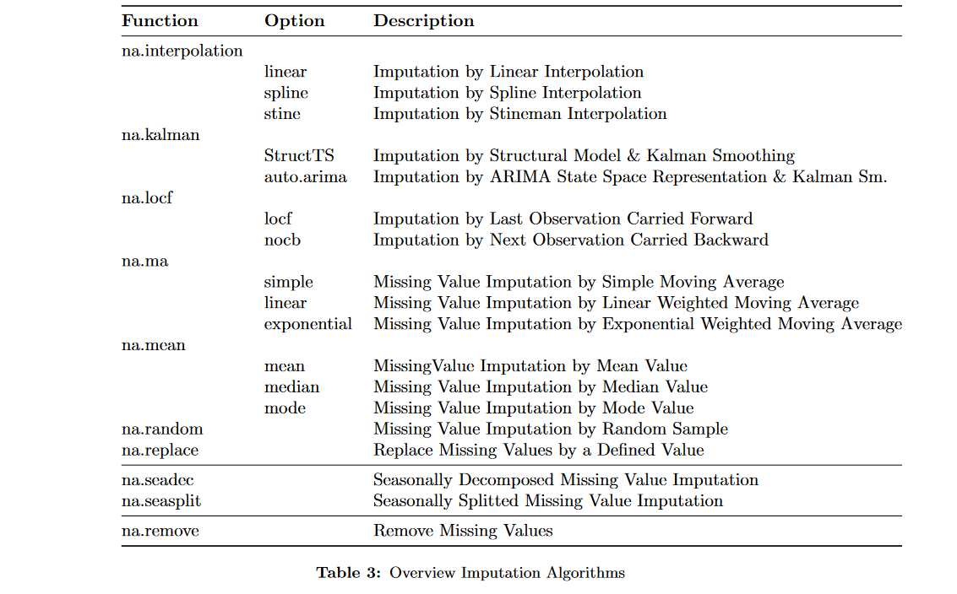
imputeTS

Slide 18
Oversampling
ML algorithms suffer when data are very unbalanced
We can do undersampling or oversampling to balance the categories: with undersampling we lose data
Conceptually oversampling is like amplifying the signal

Slide 24
Minority over-sampling with replacement
To repeat some of the observations in the data set
Has been shown not to improve the performance

Slide 26
SMOTE Algorithm
Ha & Bunke (1997) created extra training data by performing certain operations on real data: rotation and skew were natural ways to perturb
In SMOTE the minority class is over-sampled by taking each minority class sample and introducing synthetic examples along the line segments joining any/all of the k minority class nearest neighbors.
Depending upon the amount of over-sampling required, neighbors from the k nearest neighbors are randomly chosen.
The original algorithm used five nearest neighbors. For instance, if the amount of over-sampling needed is 200%, only two neighbors from the five nearest neigh-bors are chosen and one sample is generated in the direction of each.
Synthetic samples are generated in the following way:
Take the difference between the feature vector (sample) under consideration and its nearest neighbor.
Multiply this difference by a random number between 0 and 1, and add it to the feature vector under consideration. This causes the selection of a random point along the line segment between two specific features.
This approach effectively forces the decision region of the minority class to become more general

